Slide 1
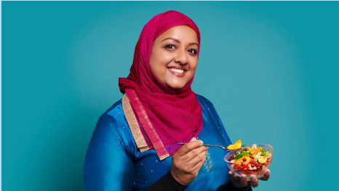
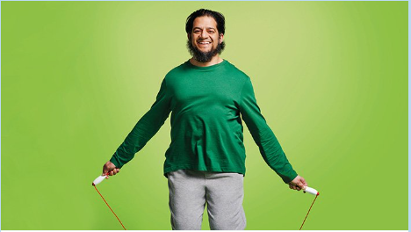
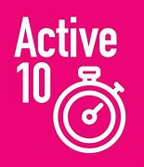
The Shrubberies Medical Centre
January 2024
12 The Shrubberies, George Lane, South Woodford, London E18 1BD
Tel: 020 85304108
www.theshrubberiesmedicalcentre.co.uk
“Appy” New Year!!
Kickstart your health
Healthy changes start with little changes. Whether you want to lose weight, get active or quit smoking, Better Health is here with lots of free tools and support.
www.nhs.uk/better-health/
Lose Weight
Losing weight is about making small, simple changes to what and how much you eat. This can really help you shed the pounds. If you're overweight, losing weight has many health benefits.
Download the free NHS Weight Loss Plan to help you start healthier eating habits, be more active, and start losing weight.
The plan is broken down into 12 weeks so you can:
set weight loss goals
plan your meals
make healthier food choices
get more active and burn more calories
record your activity and progress
Don't worry, the app makes it easy for you – just take it one week at a time.
Get Active
No matter how active you are, physical activity is good for your body and mind. Aim to be active every day…the more you do the better you’ll feel!
The Active 10 app anonymously records every minute of walking you do. Just pop your phone in your pocket and away you go!
The app:
tracks your steps
helps you set goals
shows you your achievements
gives you tips to boost your activity
Did you know walking briskly, even for 1 minute, counts as exercise? What are you waiting for - take your first steps today!

Slide 2
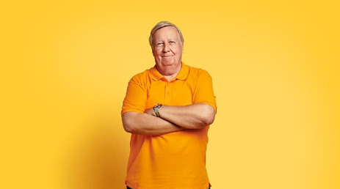
The Shrubberies Medical Centre
January 2024
12 The Shrubberies, George Lane, South Woodford, London E18 1BD
Tel: 020 85304108
www.theshrubberiesmedicalcentre.co.uk
Quit Smoking
Smoking weakens our lungs and makes it harder to breathe. Check out the free tools and tips available and join millions who have successfully quit smoking.
Use the NHS Quit Smoking app to help you quit smoking and start breathing more easily.
The app allows you to:
track your progress
see how much you're saving
get daily support
If you can make it to 28 days smoke-free, you're 5 times more likely to quit for good!
Drink Less
Drinking less can help you feel a bit better every day and it’s easier to make a change than you think.
Feel healthier, lose weight and save money by picking your days to go drink-free.
One simple way to cut down is to have at least a few drink-free days every week, so choose yours and get practical support to stick with it.
Download the Drink Free Days app
With the app you can:
update and track your drink-free days
get simple and practical tips to help you control your drinking
receive reminders when you need it most
celebrate milestones when you reach your targets
Take care of your mind
Looking after your mind is just as important as looking after your body, but it can be easily overlooked.
Every Mind Matters has lots of expert advice and practical tips to help you stay on top of your mental wellbeing.
There are little things we can all do to lift our mood or ease our anxiety – we need to find what works for us.
This could be as simple as going for a walk, prioritising our sleep or talking to a friend. Our little thing, if we keep doing it, will make a big difference to how we feel.
For more information check out
www.nhs.uk/every-mind-matters/

Slide 3
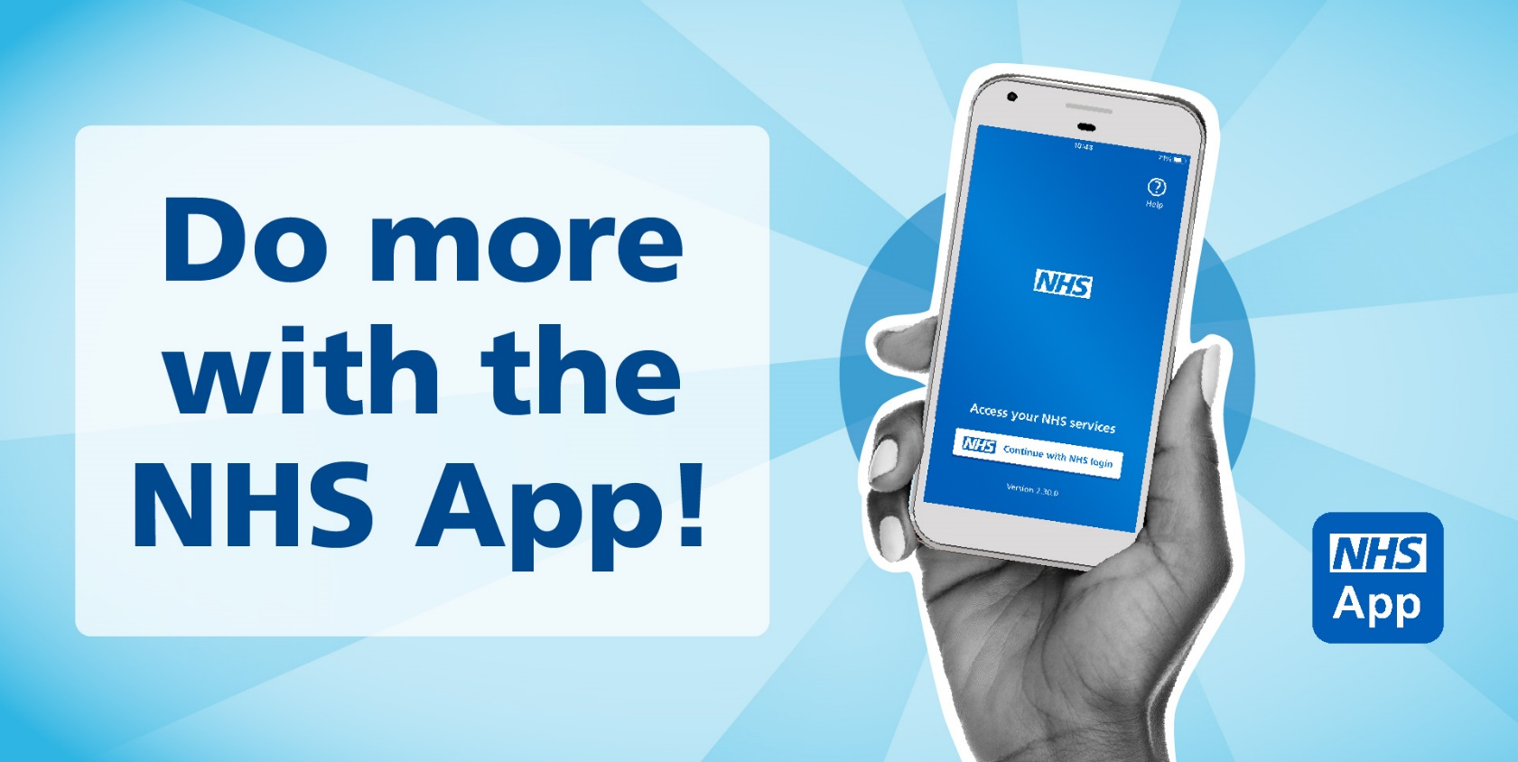
The Shrubberies Medical Centre
January 2024
12 The Shrubberies, George Lane, South Woodford, London E18 1BD
Tel: 020 85304108
www.theshrubberiesmedicalcentre.co.uk
What is the NHS App?
The NHS App is owned and run by the NHS. It can be accessed by anyone aged 13 and over registered with an NHS GP surgery in England or Isle of Man.
Once you have verified your identity in the app, you will have easy, 24/7 access to a growing range of health services and information.
It doesn’t replace existing services. You can still contact your GP surgery in the usual ways.
What does the NHS App do?
view your GP health record view your medical history, test results, allergies, and medicines
register your organ donation decision choose to donate some or all of your organs and check your registered decision
take part in health research register with Be Part of Research to help us provide better care and treatment
order repeat prescriptions request repeat prescriptions without having to contact your GP surgery
nominate a pharmacy choose a pharmacy where your prescriptions will be sent to
appointments with your GP Surgery view and cancel appointments
book and manage hospital appointments in one place you can choose your treatment provider from a list provided by your GP/referrer, and see information on most of them, including who to contact, waiting times, distance and booking details
manage vaccination appointments
book, amend or cancel vaccination appointments
linked profiles
access the health records, appointments and prescriptions of people you care for (including children) – or get help from someone you trust
search symptoms, conditions and treatments use the health A-Z to check symptoms and treatments, and get advice on what to do next
get health advice through 111 online check if you need urgent help and find out what to do next
find NHS services search for services near you
check your NHS number check your NHS number and manage your contact details within the NHS App
contact your GP surgery request care from your GP surgery using an online form
receive messages and notifications
view messages from your GP surgery and get notifications through your phone or tablet
To download the NHS App,
scan here

Slide 4
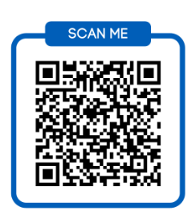
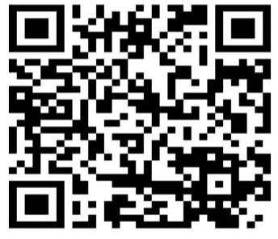
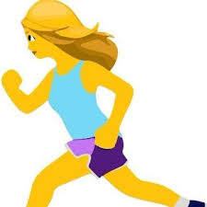
The Shrubberies Medical Centre
January 2024
12 The Shrubberies, George Lane, South Woodford, London E18 1BD
Tel: 020 85304108
www.theshrubberiesmedicalcentre.co.uk
Who’s who!
NEW…On-line registration
If you have had a new baby or know someone who would like to join the Practice, scan the QR code which will take you to the GP registration site on the NHS website.
GOOD LUCK AMY
Hi! My name is Amy and I have worked at the Shrubberies for 2 years! I enjoy working as part of the reception team, booking your appointments, answering your queries and trying my best to get you the help you need. I have administration responsibilities too including adding new patients to our surgery (which continues to grow in popularity!), setting up our clinicians’ appointment book and processing parental access to children’s records.
I started my career in banking, working for Deutsche Bank for 8 years before having my three children. Combining motherhood and work requires a certain level of energy and fitness, so I regularly work out at the gym!!
On Sunday 21 April I will be running my first London Marathon and have recently started training. I am not a natural runner so please wish me luck with this enormous challenge!
We have an active Patient Participation Group which meets regularly to discuss what has been happening in the practice. We want to understand how we can improve our service to you and how you feel about our surgery, staff and quality of care.
Your views are important and will be listened to. It may not be possible to act on every suggestion, but all feedback is extremely valuable.
We need people of all ages and backgrounds to join the team so that we can truly represent the diversity of our patients.
Interested?
Please contact
Michelle Greene 07941 077350

